Slide 1
Independent Contractor Policy
Polly Scannell, Deputy Managing Director, Office of Labor and Employee Relations
Karen Kittredge, Financial Policy Office
June 16, 2026
Internal Only

Slide 2
Logistics
Assistance: Sophie Chiasson
Ask questions: use the Q&A button
Slide deck will be available on the Independent Contractor Policy Page
Attendance: logged into Zoom?/change your name

Slide 3
Course Overview
This session provides an overview of the Independent Contractor Policy.
Policy history and overview.
Clarify workflow, timing, roles and responsibilities.
Review the Independent Contractor Questionnaire (ICQ) and the three-part legal test.
Reinforce resources available.

Slide 4

Important Notes
Individual Schools/Units may have additional policies and procedures governing independent contractors. This course does not replace local guidance. Check with your local finance office for specific policies and procedures.
If services are in the U.S., confirm international payees are eligible for payment prior to review. See Payment Eligibility Platform.
Additional restrictions apply when the services are being performed outside the U.S. Local HR Offices should work with their Global Support Services consultant for review.
Additional restrictions may apply when involving Federal funds, please review the Sponsored Programs Policies and Guidance.

Slide 5
Agenda
  Policy History and Overview
  When the Policy Applies
  Roles and Responsibilities for Compliance
  Legal Test Requirements and Use of the Independent Contractor Questionnaire (ICQ)
  ICQ Exceptions Process
  Workflow Processes
  Tips and Tricks
  Pop Quiz
  Additional Materials

Slide 6
Policy History and Overview

Slide 7
Policy History
The Independent Contractor (IC) Policy was initially released in 2010.
January 2016 – Class action lawsuit filed by massage therapists at HUHS.
  Discovery revealed variations across Harvard in IC classification procedures and practices.
  Existing IC policy focuses on federal law rather than the more restrictive Massachusetts test.
  Degree of risk is potentially substantial across University given high number of IC engagements.
September 2017 - Working group comprised of OGC, HHR, HR, Finance, RMAS and Operations formed to review current state and identify challenges and gaps.
March 2018 – Class action lawsuit was settled. Under the terms of the Settlement:
  Approximately 20 massage therapists and acupuncturists were reclassified as employees.
  University affirms its commitment to properly classify workers who provide services to the University.
  University will review and revise current IC policy to reflect both Massachusetts and U.S. law and support managers and HR staff in making correct classifications.
October-November 2018 – Working group revised IC Policy and Independent Contractor Questionnaire (ICQ). Changes to policy were vetted by Financial Policy Review Committee (FPRC) and HR Deans & Directors.
Current Updated Policy rolled out July 1, 2019.

Slide 8
Policy Key Elements
The policy clearly sets forth the legal test for appropriate IC classification required for individuals and single-employee companies. The policy:
Mandates that review and approval of IC classification must occur before IC is retained, any services are rendered, and/or payment made.
Clarifies roles and responsibilities for local hiring department or unit, HR, and accounts payable approvers; specifies required documentation, review process, and approval steps needed before any services are performed.
Clarifies that compliance is the obligation of the local department or unit.
Independent Contractor Questionnaire (ICQ) reflects Massachusetts law (which is followed regardless of where work is performed, including outside the U.S.).
Identifies lower risk engagements for U.S. activities as exceptions to ICQ requirement (but must still comply with the law).

Slide 9
Policy Overview
Policy Statement
Presumption of employee status unless 3-part Massachusetts IC test is met.
  This applies regardless of where the work is being performed (U.S. or Internationally).
A worker or department’s preference is not relevant to the classification determination.
All proposed IC engagements must be reviewed and approved as set forth in the Policy before engaging an individual.
Services cannot be rendered until an ICQ has been completed and approved and a contract signed.
Reasons for the Policy
Harvard must comply with Massachusetts and federal law.
  Wage and hour requirements (including overtime).
  Tax withholding requirements (income tax, social security and Medicare).
  Workers’ compensation, unemployment and other benefits.

Slide 10
Policy Overview, (continued)
Who Must Comply
All Harvard University schools, tubs, local units, Affiliate Institutions (e.g., Harvard Global, Wyss Institute, etc.), Allied Institutions (e.g., HUP, Arnold Arboretum, etc.) and University-wide Initiatives must comply. Harvard-affiliated hospitals are not considered affiliate institutions.
  Risks if Schools or Units Fail to Comply
  Financial liability - including taxes, workers’ compensation, unemployment benefits as well as fees and fines (which often include triple damages) assessed by both the federal and the state which must be paid by the hiring department.
  Civil and criminal liability – willful violations can incur fines or imprisonment.
  Reputational liability.
  Required registration of the University in other countries when work is performed abroad.

Slide 11
When the Policy Applies

Slide 12
When to Apply the Policy
The Independent Contractor Policy applies to the following regardless of where the work is being completed and what the payment is called (e.g., honoraria, service payment, etc.):
An individual engaged to perform a service for Harvard (see exceptions).
If services are in the U.S., confirm international payees are eligible for payment. See Payment Eligibility Platform.
Single-Employee Limited Liability Company (LLC), Unincorporated or Incorporated Company.
An ICQ is required when a company is a single-employee company (even if it subcontracts additional workers).
Third-Party Entity that Act as Freelancer Marketplace (W2 no ICQ)
If the third-party entity does not go through a formal classification process but rather acts as a freelancer marketplace (an intermediary which advertises and coordinates individuals selling their services such as Upwork, freelancer.com or TaskRabbit) an ICQ must be completed
OR
OR
Generally, based on a third-party’s structure, Parts 1 and 3 of the three-part legal test are met; however, part 2 – usual course of business must be reviewed and classified appropriately by HR.

Slide 13
How to Apply the Policy
If the policy applies, all proposed IC engagements must be reviewed and approved BEFORE a contract is signed or any services are performed.
Department or Unit completes the Independent Contractor Questionnaire (ICQ)* prior to engaging the individual to start work.
For work outside of the U.S., Harvard must follow the rules and regulations based on the country in which the work is taking place. These provisions may be different than MA law and are occasionally more stringent (Europe) or entail tax withholdings on payments to contractors.
  The local school or unit’s HR Office reviews the ICQ and determines if the individual performing the work is an employee or independent contractor.
  If work is being completed outside the U.S., the local school or unit’s HR office can work with Global Support Services (GSS) to determine international IC status.
If classified as an IC by HR, the department or unit completes and finalizes appropriate documentation (e.g., contract,
supplier set-up, purchase order, etc.) and once work has been completed processes the payment(s).
*NOTE: Under limited circumstances for services completed in the U.S., the formal completion of an ICQ is not required; however, the three-part legal test must still be met. See ICQ Exception Process section of this presentation.
For a more detailed workflow see IC Process Workflow.

Slide 14
When The Policy Does Not Apply
The Policy does not apply, and an ICQ is not required for the following performing services for Harvard.
Suppliers/vendors with more than one employee whose personnel are classified as employees (e.g., Cambridge Landscaping, AllSource)
Human Subject Payments (See Human Subject Payments Policy)
When the University is contracting with a third-party entity (e.g., managed services provider, temp agency, payrolling service, IT staffing firm) to obtain personnel who are classified by those firms as employees or contractors to perform services
Schools and departments enrolled in the Contingent Workforce Managed Services Program (Fieldglass/DZConneX/Yoh or who use the suppliers managed in the Yoh Managed Service Program meet the IC classification requirements of a managed services provider

Slide 15
Roles and Responsibilities

Slide 16

Responsibilities For Compliance
Roles | Responsibilities
Local Hiring Department or Unit | Determine if the IC Policy applies and initiate any required procedures, including completion of ICQ or determine if an exception applies. Verification individual is legally permitted to perform the services (based on visa type and work location). If classified as an IC, obtain proper review and approval before contract is signed and before any services are performed. If classified as an employee, place on appropriate payroll – see payment category and hiring method.
Local HR Office | Review proposed IC engagements per the completed ICQ using the three-part test to determine if the worker is classified as an IC or employee. Local HR Offices should work with Global Support Services around services performed outside the U.S. If classified as an employee, suggest appropriate payment category and hiring method. Ensure that departments are familiar with, and receive training regarding, IC policy requirements.
Local Department or Unit’s Accounts Payable Approver | Ensure that required documentation that supports IC classification is completed before a supplier is created in AP system or payment issued (approved ICQ or documentation of exception, signed contract, and an invoice).
Note: Individual schools and units may have more restrictive policies or internal processes; contact your tub human resources or finance department for more information.

Slide 17
Legal Test Requirements

Slide 18
Three-Part Legal Test
    Under Massachusetts law (Mass. Gen. Laws Ch. 149, sec. 148B), every individual receiving payment for services to the University is considered to be an employee of the University unless all of the factors in the 3-part Massachusetts legal IC test are satisfied. The ICQ incorporates the 3-part test.
    Note: Massachusetts IC test is among most restrictive – more restrictive than IRS test.
    The Massachusetts IC 3-part test (all 3 prongs must be met).
        Part 1: The worker must be free from Harvard’s control and direction in connection with the performance of the service, both under a contract for the performance of the service and in fact.
        Part 2: The service performed by the worker must be outside the usual course of Harvard’s business, and not a regular and continuous part of business operations.
        Part 3: The worker must be customarily engaged in an independently established trade, occupation, profession, or business of the same type as the service being performed for Harvard.

Slide 19
Part 1: Free from Harvard’s Control and Direction
The worker must be free from Harvard’s control and direction in connection with the performance of the service, both under a contract for the performance of the service and in fact.
Duties are carried out with minimal instruction/supervision or training from Harvard – IC has independent control and direction over the work.
Individual performs functions using an approach of their own choosing
  Individual sets their own hours.
  Determines the appropriate tools and methods to use.
  Uses their own materials and supplies.
  Determines when and where to work (within general parameters).
Individual determines how much work is needed to perform the project for which they have been retained.
Some indicia - Individual is being paid a flat fee by the job or project rather than an hourly rate.

Slide 20
Part 2: Outside of Usual Course of Business
The service performed by the worker must be outside the usual course of the employer’s business
The service performed by the individual must be incidental to the operations of the School, local unit, or department rather than a necessary or integrated component of operations
  Are the services a necessary or integrated component of operations?
  Does this unit typically use Harvard employees to perform these services?
  Will the individual supervise Harvard employees?
This assessment should consider whether the service is a regular and continuing part of the operations of the School, local unit, or department engaging the worker
  Duration of engagement a significant factor - Longer engagements (e.g. that exceed 6 months) are more likely to fail this prong of the test, because the services performed may be more likely to be part of the regular and continuing operations of the School, local unit, or department.
  Whether the services will be provided over an open-ended period of time, rather than a discrete or defined period.

Slide 21
Part 3: Established Trade
The worker must be customarily engaged in an independently established trade, occupation, profession, or business of the same type as the service being performed for Harvard.
Individual must be operating an independent business enterprise which offers its services to other clients or customers.
Individual must be capable of performing the services for other entities and should not be solely dependent on Harvard for work.
Fact that work is performed off-site not relevant – test is whether individual is regularly engaged in offering such services to others.
Projects that require individual to devote a substantial majority of their working time to Harvard, precluding work for others, should be limited in duration.
Some indicia - website, business email address, business card, business tax ID number.

Slide 22
ICQ Exceptions Process

Slide 23
IC Questionnaire Exceptions Process
Under limited circumstances, the formal completion of an IC Questionnaire (ICQ) is not required for services completed the U.S.*
The local department or unit must still confirm that the classification satisfies the three-part legal test.
A written contract / agreement is still required.
The local department or unit must provide the accounts payable approver with a written exception attestation form or statement of why a completed ICQ is not required.
  Guest Speaker or Guest Lecturer receiving an honorarium or speaking fee for a one-time speaking engagement (performers/musicians also fall into this category). This exception cannot be used for individuals teaching or co-teaching a substantial portion of a course, those listed as instructors in the course catalog, or those who hold a Harvard appointment for their teaching role.
  Single, Short-Term Engagements for Less than $3,000 - An ICQ is not required if the engagement satisfies the three-part Independent Contractor test; the engagement will last no longer than three months (90 calendar days); AND total payments to the IC will not exceed $3,000.
* Confirm international payees are eligible for payment prior to review. See Payment Eligibility Platform.
Note: Individual schools and units may have more restrictive policies or internal processes; contract your tub human resources or finance department for more information.

Slide 24
IC Questionnaire Exceptions Process
Guest Speaker or Guest Lecturer
Guest Speaker or Guest Lecturer receiving an honorarium or speaking fee for a one-time U.S. speaking engagement (performers/musicians also fall into this category).
  An ICQ is not required for an individual receiving an honorarium or speaking fee for a one-time speaking engagement (performers/musicians also fall into this category).
    Be sure the correct performer object code is used based on the location of the activity. See Summary of Performer Object Codes.
  This exception cannot be used for individuals teaching or co-teaching a substantial portion of a course, those listed as instructors in the course catalog, or those who hold a Harvard appointment for their teaching role.
  Schools should use Harvard templates when possible – See OGC model speaker consent forms.
Note: Individual schools and units may have more restrictive policies or internal processes; contract your tub human resources or finance department for more information.

Slide 25
IC Questionnaire Exceptions Process
Single, Short-Term Engagements
An IC Questionnaire is not required for single, short-term engagements for less than $3,000 where the activity is being performed in the U.S. if:
the engagement must satisfy the three-part IC test;
the engagement will last no longer than three months (90 calendar days);
AND
total payments to the IC will not exceed $3,000.
Note: If the local department or unit renews, extends, or enters into a subsequent engagement with the IC within a 12-month period, then then a completed ICQ is required. We are suggesting the 12-month period be based on a calendar year not fiscal year.
Note: Individual schools and units may have more restrictive policies or internal processes; contract your tub human resources or finance department for more information.

Slide 26
Workflow Processes

Slide 27
If an Individual is Classified as an IC – Local Hiring Department
Once the hiring department or unit and local HR office has determined an IC classification is appropriate, the hiring department should:
Complete Contract / Agreement using Harvard model contract templates when possible.
    The Office of the General Counsel has multiple model contracts.
    Strategic Procurement (SP) has additional master service agreement templates as well as a contract trainings which may be found on their internal website .
    Local school or unit may also have specific contracts and contract review processes.
    Any IC contract should contain the following language: [Consultant/Contractor/supplier] shall be an independent contractor, free from Harvard’s direction and control, and not an agent or employee of Harvard.
  Follow any additional requirements which may apply based on funding source or contract threshold. For example, the use of debarment language with federal funds or bid requirements based on purchasing procedure dollar thresholds. See Procurement Policy.
  Be sure to note in the contract or communicate to ICs the requirement that they follow Harvard Policy for any travel or out-of-pocket reimbursements, as well as requirements related to the Massachusetts Performers Tax and tax withholding for nonresident aliens (i.e., foreign nationals) for work completed inside of the U.S. See Performers Tax Information.
  Based on the type of service, location of service and individuals tax residency status, additional taxes may be withheld.

Slide 28
Once Work has Been Completed – Local Hiring Department and Approvers
After the work has been completed to the hiring department or unit’s satisfaction, the IC must submit an invoice and any other documentation to the school or unit for processing.
Purchasers and requestors should confirm that the required documentation has been completed (ICQ and contract) and review the invoice following the Responsibilities of Purchasers, Preparers and Approvers (ROPPA) policy.
Payment through B2P is the only acceptable method of payment for independent contractors. Harvard must not pay for IC services via out-of-pocket or by using a Harvard Corporate Card or Pcard.
Check if individual is set up as a supplier and collect required documentation to set individual up as needed.
Review and prepare invoice for payment:
  Invoices should be itemized.
  Be sure to note if work was completed within or outside the U.S.
  Use the appropriate object code based on the services completed.
    Use object codes 8690 or 8692 for ICs who earn income connected with performances in Massachusetts. Use 8691 for ICS who earn income connected with performances outside of Massachusetts. See Performers Tax for additional information.
    Other professional services (i.e., not performances) are generally processed within the M784 object code range though other object codes may also be appropriate.
    True, non-performance honoraria use object code 8694. See Performers Tax for additional information.

Slide 29
Once Work has Been Completed – Approvers
Accounts Payable Approver Responsibilities
    When submitting the invoice for approval, the hiring department or unit must have completed the required documentation listed below and the approver is responsible for ensuring that the required documentation has been completed before any payment is issued.
Required Documentation
  A completed questionnaire (ICQ), signed by HR, approving the classification of the individual as an IC or the IC Questionnaire Exception Attestation Form or language that confirms the contractor meets IC Policy exceptions.
  The completed ICQ may be submitted with the invoice or evidenced in some other way. Some Schools or Units may use Buy-to-Pay Contract Management Tool as an ICQ and contract management tool or have other internal processes for tracking that the ICQ has been completed.
  An invoice (itemized is best practice) or payment in lieu of form (e.g., guest speakers).
Approvers must review the documentation and invoice following the Responsibilities of Purchasers, Preparers and Approvers (ROPPA) policy.
If the approver does not receive or have evidence of the above required documentation, the payment cannot be processed.

Slide 30
Record Retention
        Follow University’s General Records Schedule
        Contracts, RFPs, ICQs and related materials should be retained for six years after final payment.
        Invoices must be retained 4 years after the end of the fiscal year for nonsponsored or, for sponsored, 7 years after the final project account closing unless a longer period is specified by the sponsor.
Note: The Buy-to-Pay (B2P) system will retain all materials uploaded into the system indefinitely. Materials retained include the electronic record, invoice, vendor justification form, independent contractor questionnaire, and any other materials uploaded to a record. B2P has a 5MB file size limit, with 10 files/attachments per requisition.
Best practice is to keep documents in B2P since it is the first place Central Administration and Sponsored Research will go in the event of an audit.

Slide 31
A Recap of the Most Important Points
Any individual or single-employee company performing services for Harvard is considered an employee unless the 3-part Massachusetts IC test is met.
This policy applies regardless of what the payment is called and where the activity is taking place.
A worker or department’s preference is not relevant to the classification determination
Classification of an individual or a single-employee company must occur before the individual is retained and any services are rendered.
  If paying a non-US citizen/permanent resident for services in the U.S., be sure they are eligible to receive payment before the engagement. See Payment Eligibility Platform.
Any services being performed outside the U.S. need to be reviewed by Global Support Services (often HR will work with GSS on this process). Additional information may be required to facilitate this review.
Be sure to collect and attach all appropriate documentation before approving work and/or processing payment.

Slide 32
Tips and Tricks

Slide 33
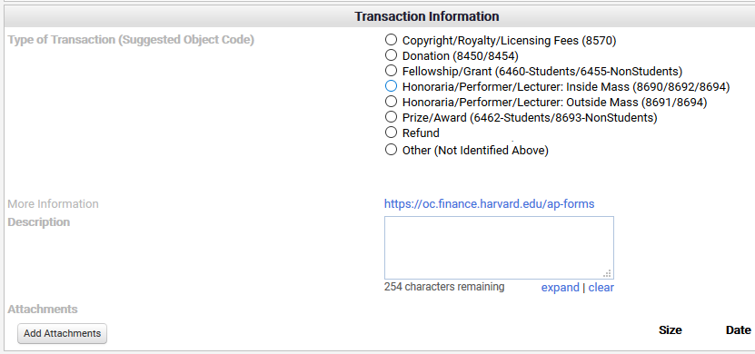
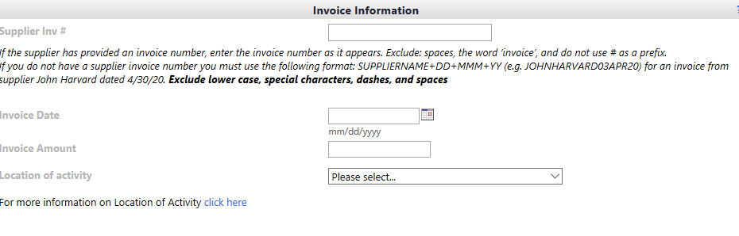
B2P Tips and Tricks – Payment Request (PR)
Make sure the type of transaction matches the description and invoice details (e.g., don’t select “Other” as type of transaction, but note “commencement guest speaker” in the description and attachment is an award letter for a prize).
Attach an invoice, in lieu of form, agreement, email correspondence.
Section | Description
❶ Type of Transaction | Select the most appropriate type of transaction. Only select “Other” if the transaction does not match one of the options listed (e.g., loan forgiveness, human subject payment, consulting, etc.). Selecting “Other” can delay review and processing since it may go into a larger queue for tax review. Be sure type of transaction matches location of activity (e.g., honoraria/performer/lecturer – Inside MA should not have a location of activity of outside the U.S.
❷ Description | Put in a detailed business purpose/description (what, where, when, why). Note the location of the activity/service.
❸ Internal Attachments | Attach an invoice or in lieu of form. This documentation shows what the payment is for and why the requestor is initiating the transaction. Documentation can be an invoice, in lieu of form, agreement, contract, or correspondence that documents the business purpose (who, what, where, when, why, how).
❹ Location of Activity | Where is the service being performed, property being rented, or the location where fellowship income is expected to be utilized.
❶
Select the help button for additional information.
❷
❸
❹
Notes:
Facilitator accessible notes:
This screenshot illustrates the key fields required when completing a payment request form. Four numbered callouts identify the sections participants should focus on:
Transaction Type – Select the appropriate transaction category from the list of available options. In this example, “Honoraria/Performer/Lecturer: Inside Mass” is selected.
Description – Enter a brief explanation of the payment request in the description field.
Attachments – Use the “Add Attachments” button to upload any required supporting documentation.
Location of Activity – Select the applicable location from the dropdown menu in the Invoice Information section.
The screenshot also shows related invoice fields, including Supplier Invoice Number, Invoice Date, and Invoice Amount, but the numbered callouts emphasize the four primary areas users need to complete.

Slide 34
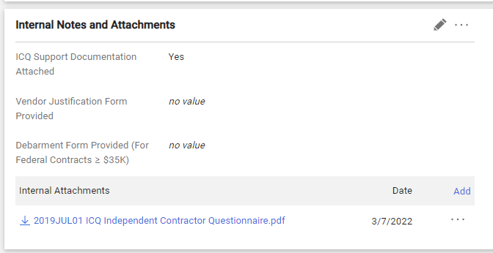
B2P Tips and Tricks – ICQ Documentation
Attach the completed ICQ to the “internal notes and attachments” section when checking out.
Attach contracts and any other required documentation to the PR or note the ICQ and/or contract is in the contract repository.
When checking out:
Select “Yes” in the dropdown on the requisition if an ICQ was required.
If an ICQ is already in the Contract Repository TCM, just note an internal comment referencing the TCM Contract Number with the ICQ document can be found to make the approvers aware if it.

Slide 35
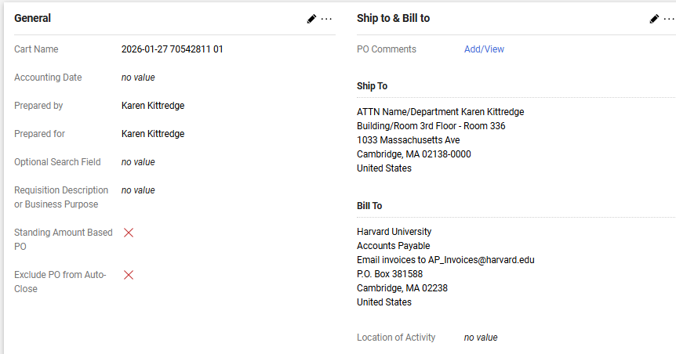
B2P Tips and Tricks – Noncatalog Order
Make sure the type of transaction matches the description and invoice details.
On the checkout page - select the location of activity to for accurate tax review.
Attach ICQ and other documentation (e.g., contract) and appropriate.
If an ICQ is already in the Contract Repository TCM, just note an internal comment referencing the TCM Contract Number with the ICQ document can be found to make the approvers aware if it.

Slide 36
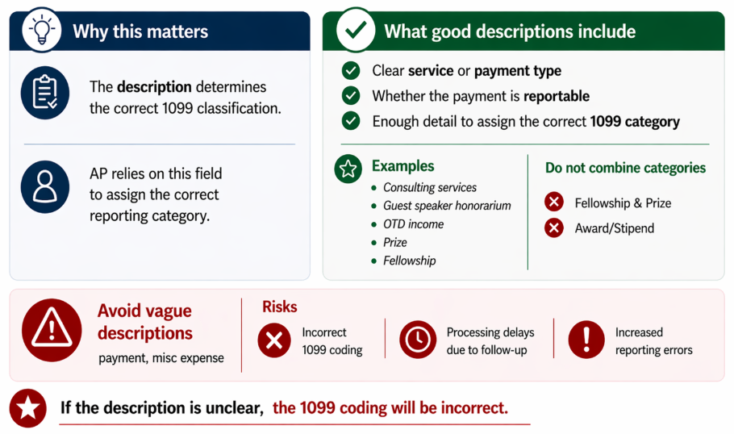
B2P Tips and Tricks – Payment Coding

Slide 37
Contacts
Department | Why Should I Contact? | Best Way to Contact
Accounts Payable Buy-to-Pay Team | Questions around accounts payable | Accounts Payable and Supplier onboarding Support ap_customerservice@harvard.edu Phone: (617) 495-8500, option 1
B2P Supplier Onboarding Team | Questions around the supplier onboarding process | ap_supplieronboarding@harvard.edu Phone: (617) 495-8500, option 3
Financial Policy Office | Questions regarding financial policies and processes | financialpolicy@harvard.edu or 617-384-7487
Global Support Services | Questions regarding international travel and risks, international programs or activities | globalsupport@harvard.edu or 617-495-1111 or School specific contact Our Team | Harvard GSS
International Payee Tax Compliance (formally NRA Tax Compliance) | Guidance regarding foreign entities or individuals including Sprintax Calculus | FAD_IPTC@havard.edu or 617-495-8500 option 5 Schedule 1:1 Virtual Appointment or Office Hours
Labor and Employee Relations | Guidance regarding policy | labor_and_employee_relations@harvard.edu
Local Human Resources Office | Questions regarding Policy, ICQ | Local Human Resources Offices | HARVie
Office for Sponsored Programs | Policies, training, and materials related to sponsored programs. | See OSP Research Administration List
Office of the General Counsel | Contract templates, specific legal questions | Contact | Office of the General Counsel

Slide 38
Test Your Knowledge

Slide 39

Pop Quiz
Q: Do I need to do an ICQ if the individual is already set up as a supplier?
A: Yes, an ICQ is based on the specific work instance and must be completed every time an independent contractor applies for work or there are changes in their scope of work.
Q: If an individual is already classified as an independent contractor, do they have to go through the independent contractor approval process each time they apply for a new contract?
  A: Yes, the taxing authorities look at each beginning and ending work period as a separate contract performed by an individual. They require full documentation for each separate contract. Caution: The taxing authorities will regard an ongoing working relationship with an individual as an employee and not an IC even if the work is intermittent.
Q: I want to hire an individual for a one-time job and payment is less than $3,000, do I need to go through the same independent contractor review process as I would for an amount above $3,000?
  A: Not necessarily, If the individual meets the three-part test for an IC and the work is being completed in the U.S., the ICQ is not required if it is a one-time engagement, the payment will not exceed $3,000 and the contract period is less than 3 months (90 days). However, an exception attestation form or other language must be submitted with the payment in order to show the school has done their due diligence in following the IC Policy.

Slide 40
Pop Quiz (continued)
Q: A department is unable to find sufficient Teaching Assistants (TA) for a three-week summer course. When this occurs, the visiting instructor will offer a TA slot to a researcher or PhD candidate at their home institution (often outside of the U.S.). Is this an employee or IC? Does this qualify as an exception due to the short duration (3- weeks) of the work and the individual will earn less than $3,000?
  A: While placing these individuals on a payroll is difficult due to the short duration of their appointment, this is a payroll transaction. The individual is performing a service that is a regular part of the school or unit’s business.
Q: I have several independent contractors who work intermittently throughout the year. Can I create a contract that is based on the entire year for each of them in order to capture all work performed during that year?
  A: No, contracts must be limited to each contract period and scope of work to be completed. Any later or additional work must go through a separate independent contractor process. If an individual is working on a regular basis, their classification may be that of employee.
Q: Do I need to follow the IC Policy if I am paying an honorarium?
  A: Yes, regardless of what the payment is called, the IC Policy must be followed.

Slide 41
Q&A Session

Slide 42
Additional Materials

Slide 43
Guidance on Classifications
MYTH: Individuals can be paid as employees, independent contractors or vendors/suppliers.
FACT: There are only two options for paying individuals – as employees or as independent contractors. An “independent contractor” is the same thing as a “vendor” or “supplier.”
Employee
Paid via PeopleSoft or an approved out-of-state or out-of-country payroll
Vendor
(May also be called a Supplier or Contractor and may be paid for the purchase of goods and/or services.)
Paid via Accounts Payable (B2P)
NOTE: Both individuals and entities can be a vendor.
Individual
Generally being paid compensation or salary and wages in exchange for past, present or future services that are primarily for Harvard’s benefit.
Requires a Form I-9
Receives a W-2
May have income taxes withheld
Can be operating as a single individual, or a multiple employee business
Can be unincorporated, an individual person, a company, LLC, business, partnership, nonprofit, government agency, trust/estate, etc.
Individuals or single-person companies (regardless of company type) must comply with the Independent Contractor Policy
Foreign vendors (individual or entity) may have taxes withheld depending upon the payment type and tax status
May receive a 1042S or 1099 based on vendor and payment type and tax status
Internal Only - 2026JUN16

Slide 44
Do I need to do an Independent Contractor Questionnaire?
An independent contractor questionnaire (ICQ) must be completed prior to engaging the individual to start work and regardless of where the work is being completed (both inside and outside Massachusetts). For work outside of the U.S., Harvard must also follow the rules and regulations based on the country in which the work is taking place. These provisions may be different than MA law and are occasionally more stringent (Europe) or entail tax withholdings on payments to contractors. See the Independent Contractor Policy.
Who is completing the service? | Do I need to complete an Independent Contractor Questionnaire?
An individual | YES - An Independent Contractor Questionnaire is required or must meet the school’s process regarding exceptions.
A single-employee Limited Liability Company (LLC), Unincorporated or Incorporated Company | YES - An Independent Contractor Questionnaire is required or must meet the school’s process regarding exceptions.
A multiple-employee (more than one employee or partner) Limited Liability Company (LLC), Unincorporated or Incorporated Company | NO - An Independent Contractor Questionnaire is NOT required, but other policies may apply.
An entity - LLC, Unincorporated or Incorporated company or business that has more than one employee | NO - An Independent Contractor Questionnaire is NOT required, but other policies may apply.
Third-Party Entity that Act as Freelancer Marketplace and does not go through a formal classification process | YES - An Independent Contractor Questionnaire is required or must meet the school’s process regarding exceptions.
A human subject payment | NO - An Independent Contractor Questionnaire is NOT required, but other policies may apply.
Third-Party Entity that classifies their personnel as employees (e.g., managed services provider, temp agency, payrolling service, IT staffing firm) | NO - An Independent Contractor Questionnaire is NOT required, but other policies may apply.

Slide 45
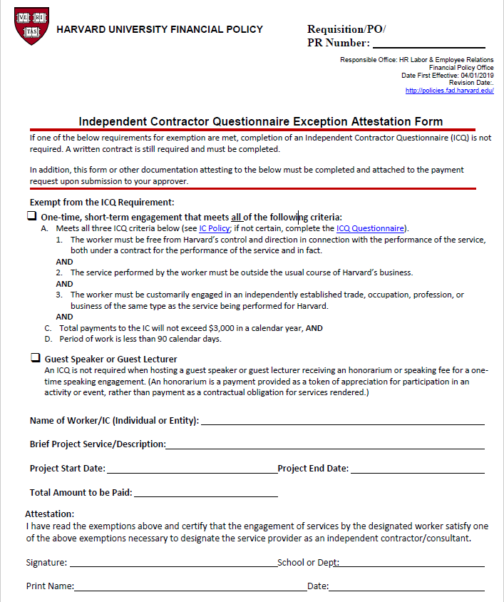
ICQ Exception Attestation Form

Slide 46
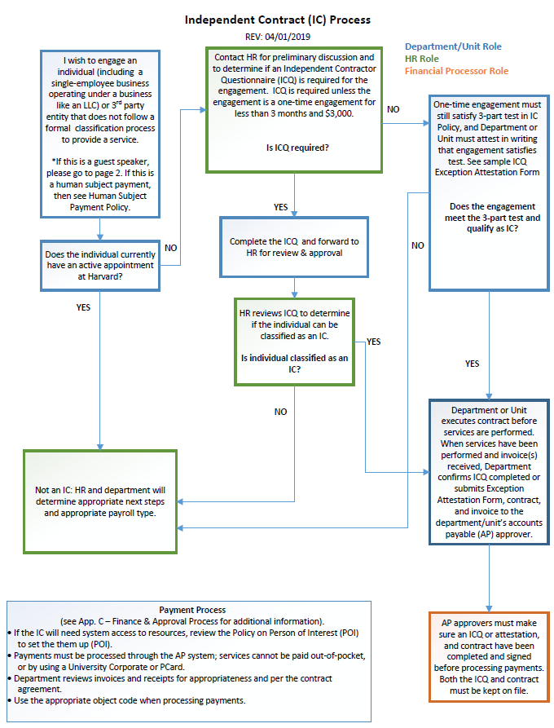
IC Process

Slide 47
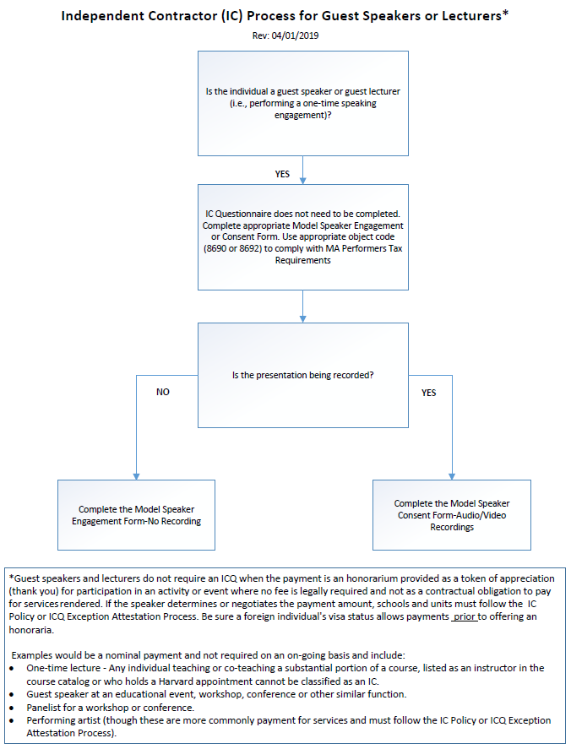
IC Guest Speaker / Lecturer Process

Slide 48
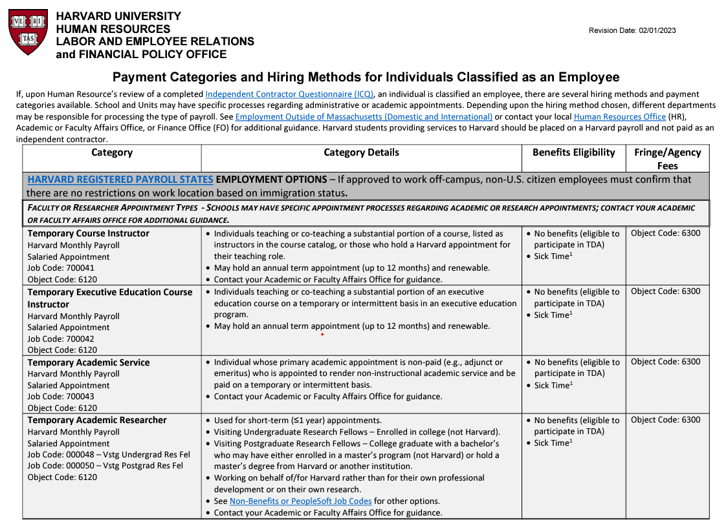
Sample of document. Complete document can be found here.
Internal Only - 2026JUN16

Slide 49

Summary of Object Codes
Lecture / Performance
Held Outside of Massachusetts Use Object Code 8691
(Lect Perf OUTSIDE MA - honoraria/svc pmt/fees to vistng lect/perf)
Individual or entity was not located in Massachusetts when they performed the service
Lecture / Performance
Held Inside Massachusetts
Use Object Code 8690
(Lect Perf IN MA WH Ex-honoraria/svc pmt/fees to vis lec/perf/ent(pmt holds))
No Exemption Attestation
Lecture / Performance
Held Inside Massachusetts
Use Object Code 8692
(Lect Perf IN MA WH Ex-honoraria/svc pmt/fees to vis lec/perf/ent(pmt holds)
Includes Exemption Attestation
Individual or entity was in Massachusetts when they performed the service
Individual - Non-Performance Related Honoraria Use Object Code 8694
(Honoraria-Individual "non performance" related)
Not subject to the Massachusetts Performer tax (though they may be liable for other taxes based on their location and immigration status)
Individual or entity has completed the Attestation Form for Claiming Exemption or Reduction in Withholding acknowledging they submitted a Form PWH-WW or PWH-RW to Mass Department of Revenue at least 10 days before the event
Central Accounts Payable will review the documentation and adjust tax liability as appropriate.
Non-performance payment that is classified as an honorarium.
Payments may be classified as honorarium or service payments
Payments may be classified as honorarium or service payments
Payment is to an individual (not entity) and is one-time payment for which no fee is required or set. For example, a juror on an award selection committee.
Non-performance related payments to an entity would most likely be in the 79XX object code series.
Internal Only - 2026JUN16

