Slide 1
Business Expense Reimbursements Policy
Financial Policy Office
Office of the Controller
July 26, 2017
Karen Kittredge, Mgr. Policy and Business Process
Andrea Sexton, Director of Financial Policy and Compliance

Slide 2
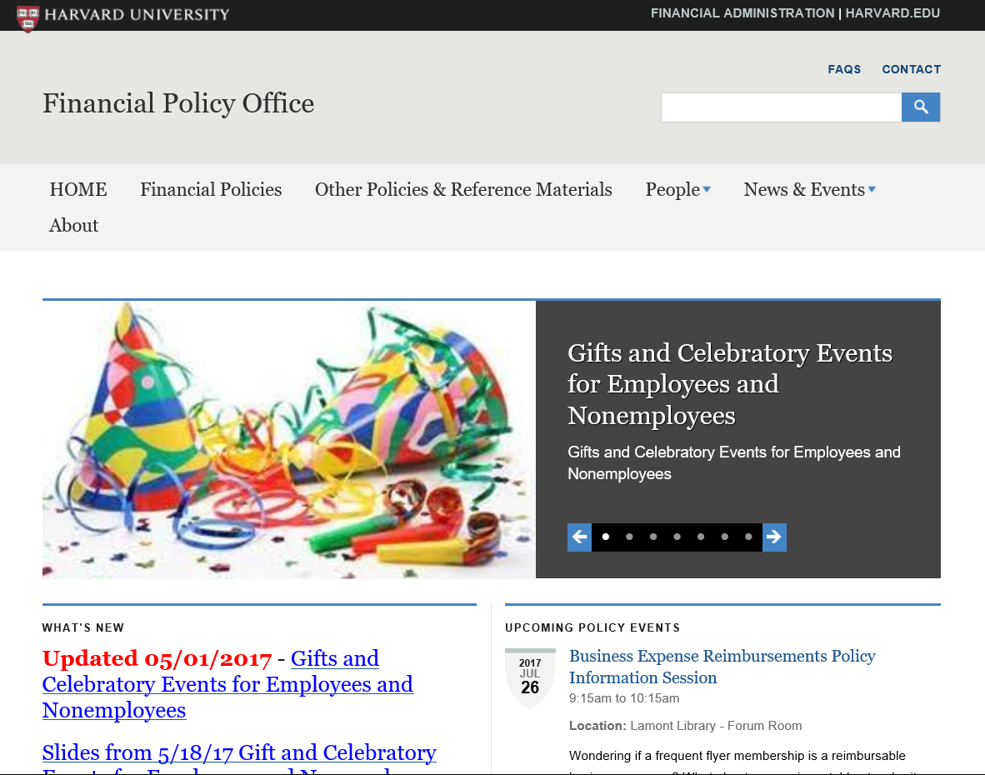
Financial Policy Website: policies.fad.harvard.edu

Slide 3
Agenda
The Accountable Plan Rules
Common Questions
Business Meals
Gifts
External Organizations
Pop Quiz
Common Errors

Slide 4
IRS Rules - The “Accountable Plan”
SUMMARY OF ACCOUNTABLE PLAN RULES
Must be substantially business-related – not a personal expense
Must be substantiated – documented with receipts and business purpose
Reimbursement request must be submitted timely (90 days)
Amount reimbursed can’t exceed actual expense
Any time Harvard gives money or other value to an individual, it can have tax implications.
The “Accountable Plan” is the set of IRS rules Harvard must follow to ensure reimbursements are not taxable to the recipient/reimbursee.
The rules aren’t necessarily intuitive. Some expenses -- even though they relate to work – are still considered personal expenses (commuting, professional attire, etc.)

Slide 5
Foundation of IRS Rules
Taxable can mean a few different things:
Gross income: required to be reported on a personal tax return. Every single time Harvard transfers money or other value to someone, even to reimburse that person for an expense, it’s considered gross income to the recipient – unless an exclusion applies.
Withholdings: taxes taken out of a payment up front
Reportable: required to be reported to the IRS and the individual
NOTE: The source of funding (i.e., sponsored research award) does NOT affect the tax treatment of the expense. The tax treatment of the expense ALWAYS hinges on whether or not it the particular expense is in DIRECT SUPPORT of University business.

Slide 6
Business-Related
For Harvard to reimburse an expense without tax implications, the expense must be:
Ordinary – common and accepted in the normal course of University activities;
Necessary – appropriate in nature and amount; and
Business-Related – not a personal expense
Requirements:
A complete business purpose (who, what, when, where, why)
Notes:
Citations should be italicized and bibliographical – note the bar symbol separating the citation and the wordmark.

Slide 7
Substantiation
Expenses over $75 must be substantiated with receipts.
A Missing Receipt Affidavit (MRA) is required for lost receipts over $75 or for missing hotel folios. MRAs must be used as exceptions, not on a regular basis.
What should a receipt include?
Date of transaction
Name of merchant
Transaction details (what was purchased )
The amount of purchase
The form of payment used (credit card, cash, check)
Indication that the amount was paid
Handwritten receipts require a MRA
Notes:
Citations should be italicized and bibliographical – note the bar symbol separating the citation and the wordmark.

Slide 8
Timely
Harvard Employees: Concur reports must be submitted to Travel and Reimbursements using the below time table.
Days after transaction date | Result
 | No tax implications Expenses on Corporate Card should be paid by statement due date
 | Expense treated as income to employee – must be processed as additional pay with taxes withheld May NOT be grossed up
 | Expense may NOT be paid with University funds
0-90
91-182
183+
Non Harvard Employees: While reimbursements to non-employees are not technically bound by the same 90-day deadline, Harvard encourages units to pay non-employee expenses in the same fiscal quarter as they are incurred.
Notes:
Citations should be italicized and bibliographical – note the bar symbol separating the citation and the wordmark.

Slide 9
What is a Harvard Employee?
Employee Concur | Nonemployee HCOM
Bi-Weekly (PFX, PON, POU) | Weekly Temps (includes less-than-half-time) (LHT, WTM, WST)
Faculty Monthly (MFC) | Hires Pay Group (HRH, HRA, HRM, HRW)
Internal Post-Docs (MIP) | Students (stipend) (MST)
 | External Post-Docs (MEP)
 | Monthly Teaching Fellows (MTF)
 | Non-Paid (NPD)
 | Long-Term Disability (LTD)
 | Retiree Payrolls (RET, RMF)
 | Outsourced Payrolls (OUB, OUM, OUS, OUW, OWC)
Notes:
Gloss over – basically, you get benefits you are an employee.

Slide 10
Common Sources of Reimbursement Questions
Not Reimbursable | Everyday clothing and footwear (even formal wear for a University event) Home office furniture and equipment (even if used when working from home) Daily commuting expenses from home to regular place of work Regular meals (i.e., not “business meals”) Personal services (i.e., barber, hairstylists, etc.)
Sometimes Reimbursable | Expenses payable by outside organizations Overnight hotel stays near campus Laundry
Typically Reimbursable | Software, e-books used for a Harvard project Books that are used for a Harvard project and that will remain University property Purchase or rental of regalia for employees participating in commencement exercises
Notes:
Mention athletic fees for hotels.
Not hotel frequent guest programs

Slide 11
Meals
Business meals are meals with faculty, staff, students, donors, or other external parties during which specific documented business discussions take place. All meal costs must be substantiated by a complete and explanatory business purpose.
Employees should use good business judgment when choosing restaurants. Meal costs inappropriate to the situation will not be reimbursed.
Charges for alcohol, including very small dollar amounts, cannot be charged to sponsored awards. Even when charging against unrestricted funds, diners should exercise discretion and good judgment when charging alcohol as part of a business meal.
Individual meals: Harvard can reimburse travelers for reasonable individual meal expenses while on University business. Does not include one-day travel unless travel time is greater than 12 hours.
Notes:
. Business Judgment: Avoid high-end establishments must be avoided unless circumstances dictate that such a choice is appropriate, as when conducting University business with a major donor or foreign dignitary.

Slide 12
Gifts
Gifts to employees
Harvard can give gifts of tangible property valued at less than $100 to employees without tax implications
The $100 must include any taxes, shipping, or other fees
This includes sympathy gifts, such as flowers or donations to a charity in lieu of flowers
Can make special award up to $400 to long-service (>=5 years) employees once every five years; must be presented as part of a meaningful acknowledgement of service
Gifts to nonemployees
Must be made out of disinterested generosity – not disguised payment or compensation

Slide 13
External Organizations
Payments by outside organizations
Individuals should not seek payment from Harvard for business-related expenditures that will be reimbursed from another source. Where travel and other expenses will ultimately be paid by a third party, travelers should seek reimbursement from the third party directly.
Under extenuating circumstances, such as uncertainty regarding the outside organization’s willingness to pay or a multi-leg trip with expenses payable by Harvard and an outside entity commingled, Harvard may reimburse an individual for some or all expenses with Financial Dean approval.
Under no circumstances will Harvard provide up-front payment for expenses that are not related to University business, even if the recipient intends to later reimburse Harvard.

Slide 14
Pop Quiz!
Q: A faculty member submits a reimbursement request for an airline club membership. The business purpose noted is that the club is used when waiting a hour between flights to work on Harvard business.
A: This is not allowable. While the expense appears reasonable, the membership is in the individual’s name and can be used for personal use.
Q: A tub’s Development Office purchases a membership to the Harvard Faculty Club of New York. They note the membership will be used to house staff while on business in NY and they will use the facilities for developmental programs and events.
A: This would be allowable with Financial Dean approval. While the expense is not ordinary, it is being used in several ways for University business. The membership must be under the name of a Harvard Department and not an individual.
In rare cases, other types of memberships may be allowable (e.g., Amazon Prime); however these memberships must be approve by a Financial Dean, linked to a Harvard-only Business non-taxable business account, linked to a Harvard email account and may only be used for Harvard-related business.
Q: An employee submits a receipt to be reimbursed for parking in Harvard Square for an early morning business meeting.
A: Are there additional details? Local parking (parking on or near the Harvard campus such as 123 Mt. Auburn, Harvard Square or other campus parking) is only allowed if there is a clear and reasonable business case and it benefits the project directly. Examples may include:
The event begins or ends after normal working hours,
for security/safety (not walking back to regular parking late at night);
For medical reasons; and/or
For transportation of items to meeting/event.
14

Slide 15
Pop Quiz!
Q: A research assistant is flying to a country that requires specific immunization shots and requires a special VISA to get into the country.
A: Costs associated with obtaining the necessary VISAs and immunizations required for travel to non-U.S. destinations on Harvard business are allowable.
Q: Aren’t allowance reimbursements (non-travel reimbursements related to an annual research or professional expense allocations), allowed to be processed after 90 days with no tax implications?
A: Allowance reimbursements are not allowed and submission of receipts must follow the accountable plan rules and time limits.
Q: An employee traveling for 2 weeks submits for reimbursement for hotel laundry services.
A: Individuals on travel for over 5 days are eligible for laundry service expenses.
Q: A faculty member is a keynote speaker at a conference in Italy. The conference will pay them an honorarium and travel costs. Should Harvard pay for the plane ticket and be reimbursed later?
A: These are payments from outside organizations. The faculty member should incur expenses on their personal credit card and be reimbursed directly by the outside organization.
Q: Same instance as above, but the faculty member says that Harvard is benefiting from this conference since they are a Dean and are representing Harvard. They believe Harvard should pay for the plane ticket and request reimbursement from the outside organization.
A: It can be difficult to determine personal and Harvard business. In the above instance, unless there is an extenuating circumstance, such as the outside organization’s willingness to pay or a multi-leg trip which includes Harvard business, because the faculty member is receiving an honoraria, the expenses lean more towards personal than Harvard business.
15
Notes:
Faculty Keynote: Honoraria going to him – thus personal. Harvard should not be a middle man.

Slide 16
Common Errors
Reimbursement requests are often returned or rejected because of…
Missing or insufficient detailed business purpose
Missing Receipts over $75.00 or no signed Missing Receipt Affidavit (MRA)
Nonemployee reimbursement is processed as a Payment Request (PR) rather than a Non-Employee Reimbursement (NR) through HCOM
Per Diem limits are exceeded
Expenses are taxable to an individual
Sympathy flowers to an employee exceed $100
Gift certificate to an employee
Expenses exceeding 90 days which do not include the appropriate additional pay form
Corporate card payments which are taxable must include
Add Pay form with “No Check Required” written on the top of the form
Add Pay form and associated receipts included in the Concur expense report header
The “Includes additional pay” box is checked at the expense report header in Concur

Slide 17
Additional Materials
BEN Reimbursement Type - Foreign Individual
Fellowship Payments and Reimbursements for Students and Non-Employee Postdocs/Fellows
Gifts and Celebratory Events for Employees and Nonemployees
Job Aid on Completing Reimbursement Forms
Sponsored Programs Policies
Travel Policy

